Slide 1


Project 3
Python

Slide 2


Proposal:
To automate a monthly sales reporting process for a small [$3+ Billion] mutual fund company.

Slide 3
Why?
The reporting of these sales is currently a disruptive and heavily manual process.

Slide 4
Benefits:
An annual savings of $50,000 per annum in manpower hours.
Elimination of human error in reporting.
Reduction in audit time
Eliminates the Opportunity Cost of lost time that is normally spent on conducting sales activities.
Increased employee job satisfaction.
Standardizes the reporting, thus allowing for in depth analysis of sleeve sales data.
Allow for Ad Hoc Analysis.

Slide 5

How to Start?
Coding from…Scratch.
Sales Report consists of excel spreadsheet with 20,000 rows, 15 columns, $400 million in sales.
17 different sales types
-80+ variations
Each needs to be coded

Slide 6

How to Start?
Moments of…

Slide 7
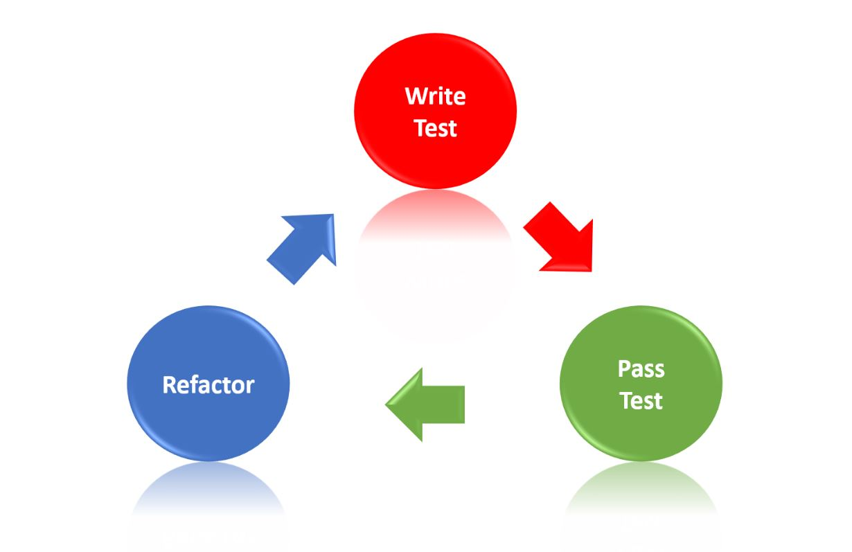
How to Start?
Test Driven Development:
-Develop Test Data
-Write Code to deliver Positive result
-Test Code
-Refactor

Slide 8
Build the Test Data Set

Slide 9
Build the Test Data Set
Contains 5 variations:
Sale AUM
a b
b a
a a/b
b a/b
a/b /

Slide 10
Build the Test Data Set
Code for positive ‘Result’
df["Result"][(df["B SALE"] >= df["AUM A"]*0.1= "DP1"

Slide 11
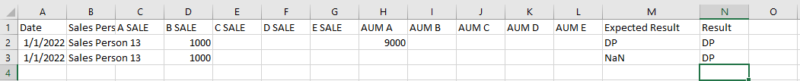
Build the Test Data Set
Code for positive ‘Result’
df["Result"][(df["B SALE"] >= df["AUM A"]*0.1= "DP1"
Code for negative ‘Result’

Slide 12
Build the Test Data Set
Code for positive ‘Result’
df["Result"][(df["B SALE"] >= df["AUM A"]*0.1= "DP1"
Code for negative ‘Result’
df["Result"][(df["B SALE"] >= df["AUM A"]*0.1) & (df["AUM B"].isnull())] = "DP1"

Slide 13
The Code seemed to have a natural progression
df["Result"][(df["B SALE"] >= df["AUM A"]*0.1) & (df["AUM B"].isnull())] = "DP1"
df["Result"][(df["B SALE"] > 0) & (df["AUM B"] >= df["AUM D"]*0.1) & (df["AUM D"] >= df["AUM B"]*0.1)] = "IDP1.3"
df["Result"][(df["A SALE"] >= df["AUM E"]*0.1) & (df["AUM E"] > 0) & (df["A SALE"] >= df["AUM B"]*0.1) & (df["AUM B"] > 0)] = "TT1.4"

Slide 14
The Code seemed to have a natural progression…Till
‘The Paired Trade’

Slide 15
Initial code:
df["Result"][(df["B SALE"] >= df["AUM A"]*0.1= "DP1"
‘The Paired Trade’ code
test_1 = df[((df["LCSIX SALE"] > 0) | (df["LFMIX SALE"] > 0 ))
& (df["AUM LFMIX"].isnull())
& (df["AUM LCSIX"].isnull())
& (df["AUM LOTIX"].isnull())
& (df["AUM LSPIX"].isnull())
& (df["AUM LEQIX"].isnull())
# & (df["LEQIX SALE"].isnull())
]
test_1.set_index(["Settlement Date","Advisor name"])
test_1["Settlement Date"].unique()
test_1["Advisor name"].unique()
final = pd.DataFrame()
for i in test_1["Settlement Date"].unique():
for j in test_1["Advisor name"].unique():
a = test_1[(test_1["Settlement Date"] == i) & (test_1["Advisor name"] == j)]
test_a = a[((a["LCSIX SALE"] > 0) | (a["LFMIX SALE"] > 0))
& (a["AUM LFMIX"].isnull())
& (a["AUM LCSIX"].isnull())
& (a["AUM LOTIX"].isnull())
& (a["AUM LSPIX"].isnull())
& (a["AUM LEQIX"].isnull())
& (a["LEQIX SALE"].isnull())
]
test_a["Result"] = "DPp"
df3 = final.append(test_a, ignore_index=True)
df3

Slide 16
Random Generated Data

Slide 17
Random Generated Data
Data Collection and Preparation:
-Import CSV
-Replace the White Space
-Remove Commas
-Fixing Data types

Slide 18
Running code finished so far..

Slide 19
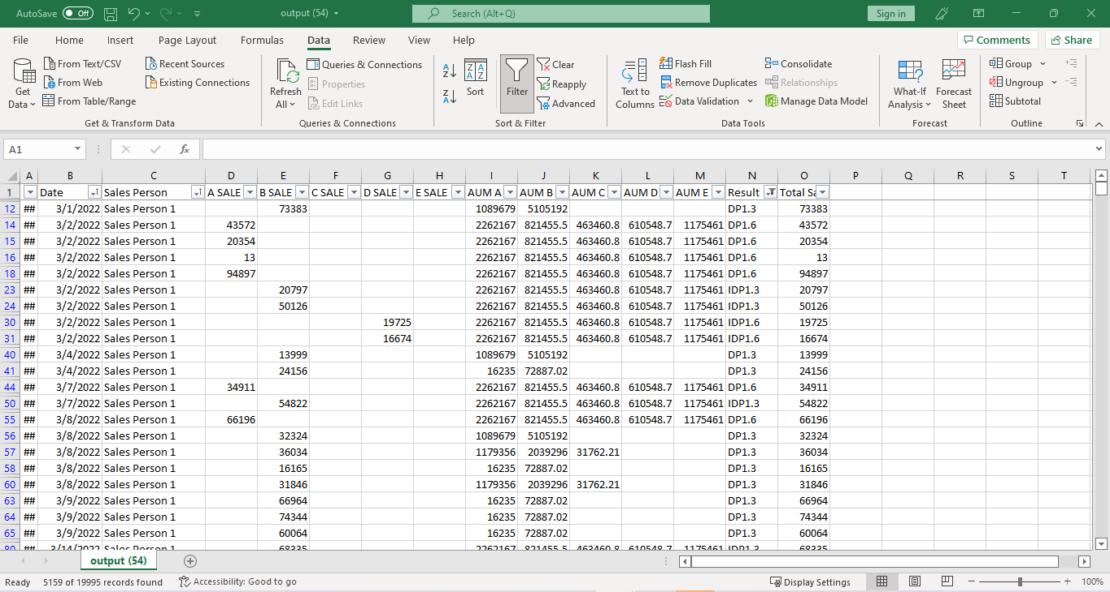
Report Formatted in a Excel Spreadsheet.

Slide 20
Analysis [Seaborn]
Seaborn is a Python data visualization library based on matplotlib. It provides a high-level interface for drawing attractive and informative statistical graphics

Slide 21
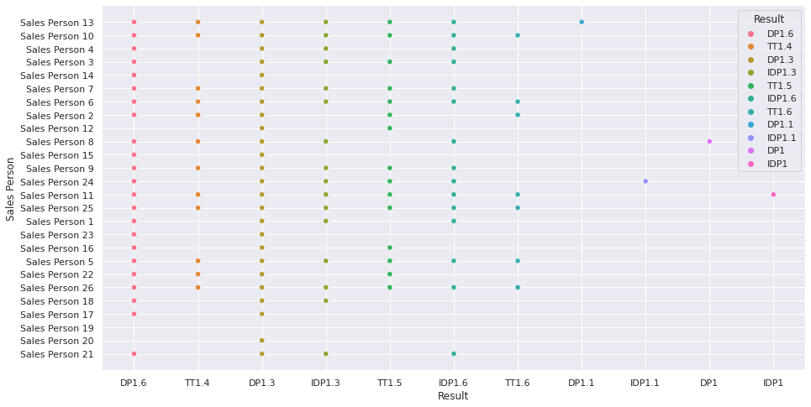
Types of Sleeve Sales by
Sales Person

Slide 22
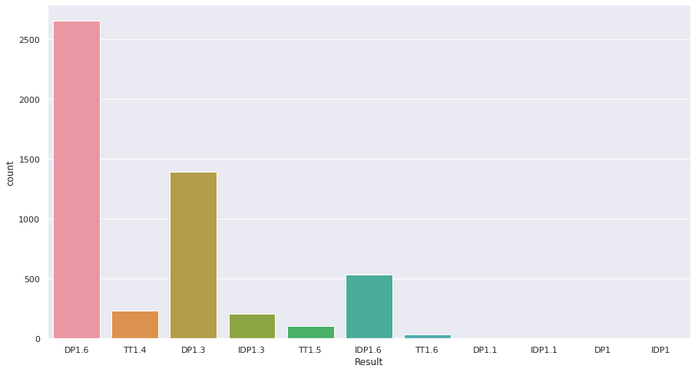
How Often a Sale qualifies for a sleeve commission.

Slide 23
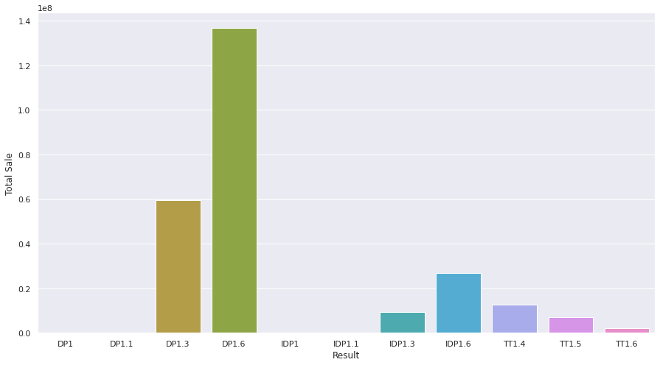
Total dollar amount in each type of sleeve. [in Hundreds of Millions]

Slide 24
Summary / Next Steps
The pre-alpha coding and tests have shown that a report that currently takes 40+ man hours a month to complete can be cut down to to 1 hour or less, yielding several benefits.
Continue code development to fruition and deploy successfully.
Continue exploring avenues of analysis to help executive level management better understand sales flows.

Slide 25
?

